Slide 1



Interestingness Measure: Correlations (Lift)
play basketball ⇒ eat cereal [40%, 66.7%] is misleading
  The overall % of students eating cereal is 75% > 66.7%.
play basketball ⇒ not eat cereal [20%, 33.3%] is more accurate, although with lower support and confidence
Measure of dependent/correlated events: lift
 | Basketball | Not basketball | Sum (row)
Cereal | 2000 | 1750 | 3750
Not cereal | 1000 | 250 | 1250
Sum(col.) | 3000 | 2000 | 5000

Slide 2
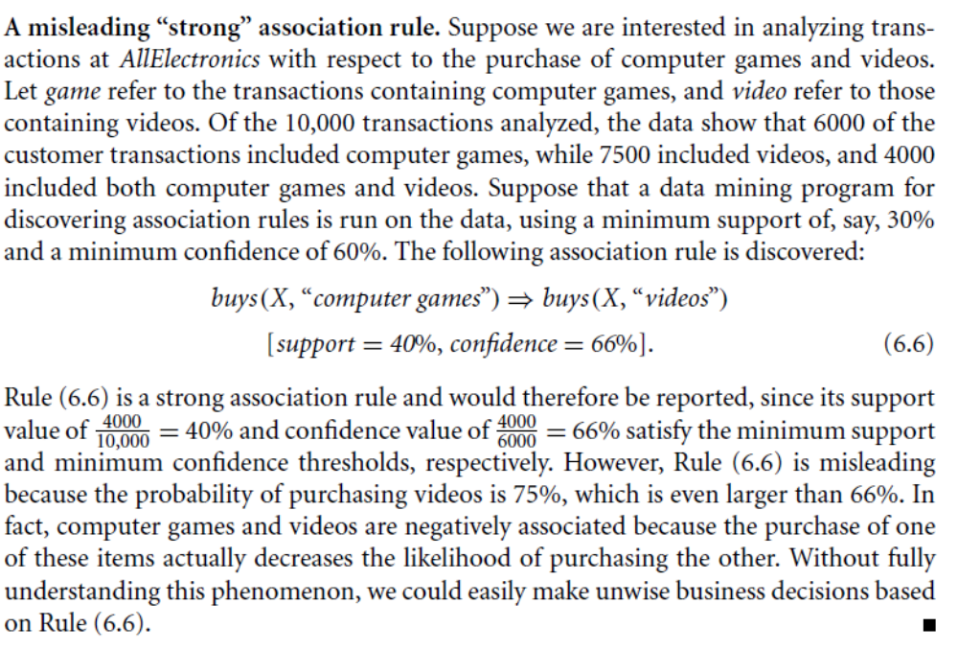

Slide 3
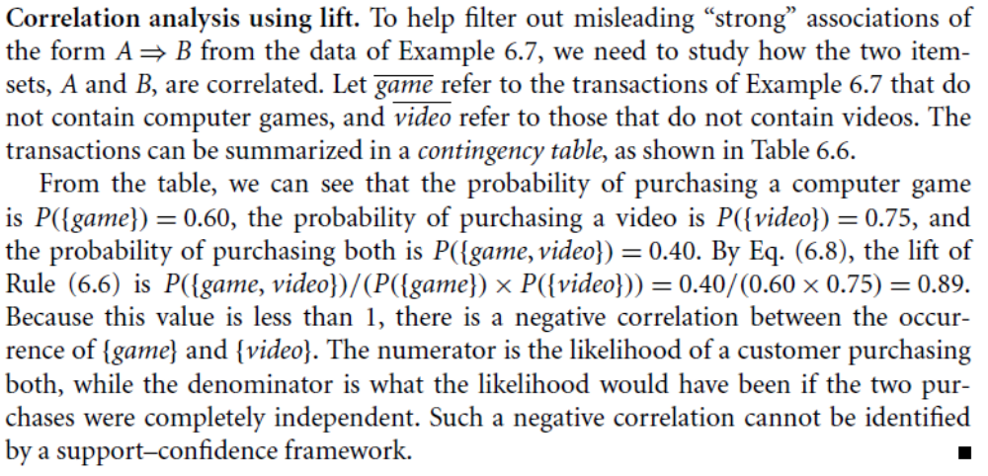
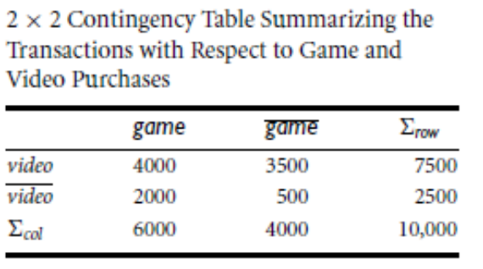

Slide 4
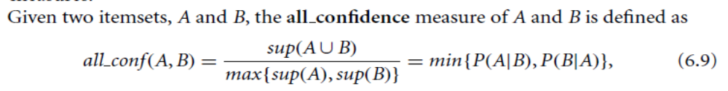
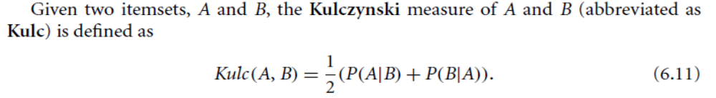
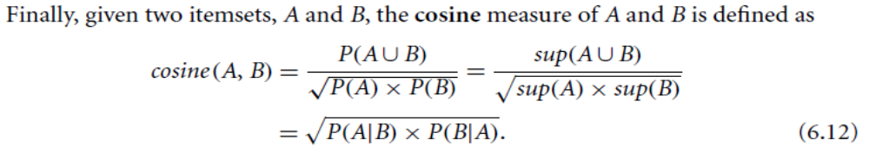

Slide 5
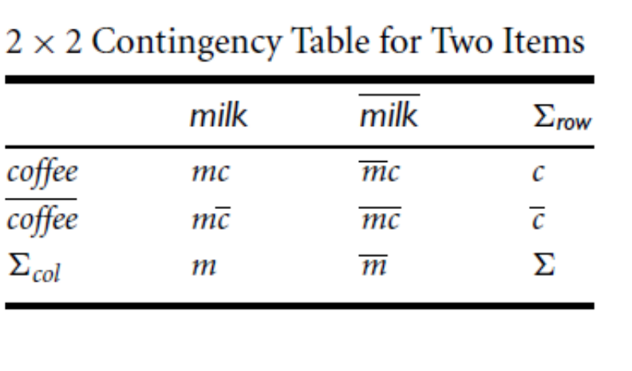
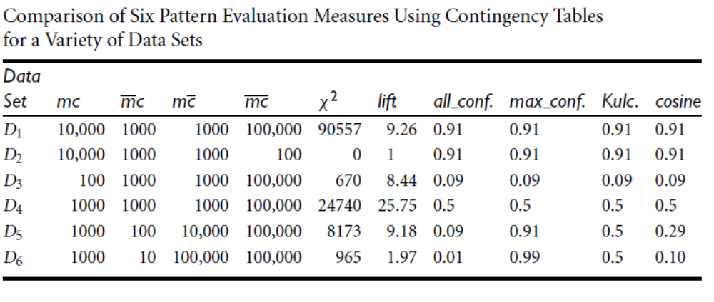

Slide 6
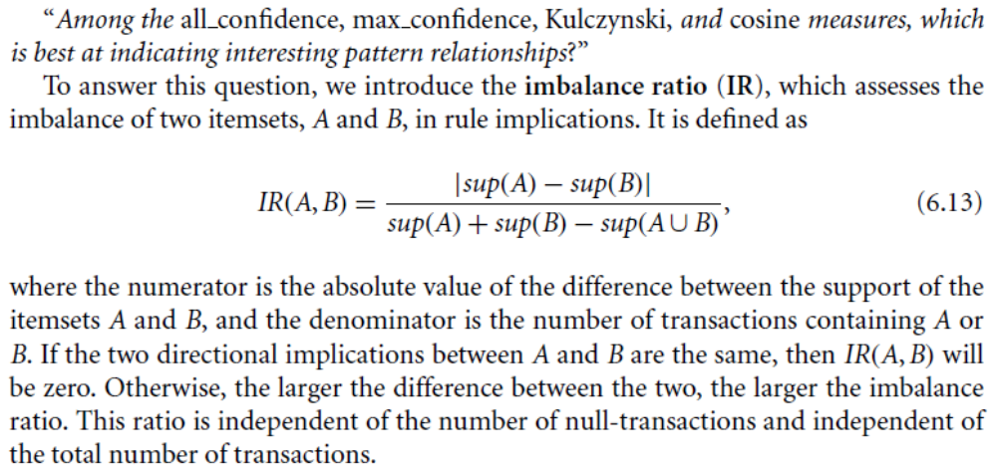

Slide 7

Are lift and χ² Good Measures of Correlation?
“Buy walnuts ⇒ buy milk [1%, 80%]” is misleading if 85% of customers buy milk
Support and confidence are not good to indicate correlations
Over 20 interestingness measures have been proposed (see Tan, Kumar, Sritastava @KDD’02)
Which are good ones?

Slide 8
